Slide 1
Chapter 18
Transformers

Slide 2
Objectives
After completing this chapter, you will be able to:
Describe how a transformer operates
Explain how transformers are rated
Explain how transformers operate in a circuit
Describe the differences between step-up, step-down, and isolation transformers
Describe how the ratio of the voltage, current, and number of turns are related with a transformer
Describe applications of a transformer
Identify different types of transformers

Slide 3
Electromagnetic Induction
Transformer
Consists of two coils, a primary winding and a secondary winding
Rated in volt-amperes (VA)
Primary winding
Coil containing the AC voltage
Secondary winding
Coil in which the voltage is induced

Slide 4
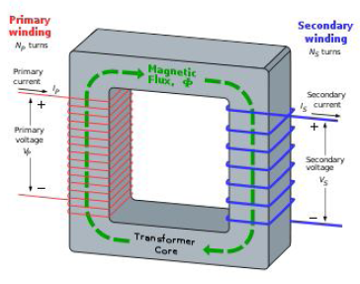



Slide 5
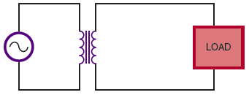
Mutual Inductance
Expanding magnetic field in loaded secondary causes current increase in primary
Figure 18-4.Transformer with a loaded secondary.

Slide 6
Turns Ratio
Turns ratio
Determines whether the transformer is used to step up, step down, or pass voltage unchanged
Can be expressed as:
turns ratio = N_{S}/N_{P}
where: N = number of turns

Slide 7



Slide 8
Turns Ratio (cont’d.)
Step-up transformer
Produces a secondary voltage greater than its primary voltage
Turns ratio is always greater than one
Step-down transformer
Produces secondary voltage less than its primary voltage
Turns ratio is always less than one

Slide 9
Applications
Transformer applications include:
Stepping up/down voltage and current
Impedance matching
Phase shifting
Isolation
Blocking DC while passing AC
Producing several signals at various voltage levels

Slide 10
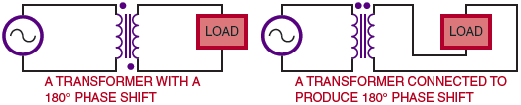
Applications (cont’d.)
Figure 18-5. A transformer can be used to generate a phase shift.

Slide 11
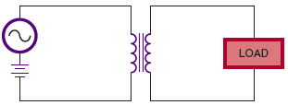
Applications (cont’d.)
Figure 18-6. A transformer can be used to block DC voltage.

Slide 12
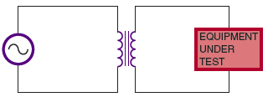
Applications (cont’d.)
Figure 18-7. An isolation transformer prevents electrical
shock by isolating the equipment from ground.

Slide 13
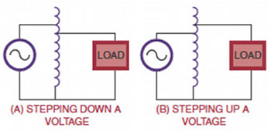
Applications (cont’d.)
Figure 18-8. An autotransformer is a special type of transformer
used to step up or step down the voltage.

Slide 14
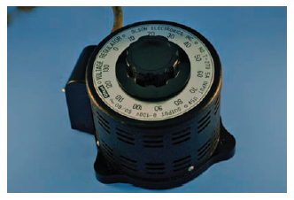
Applications (cont’d.)
Figure 18-9. A variable autotransformer.

Slide 15
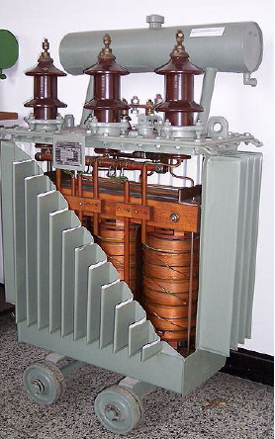
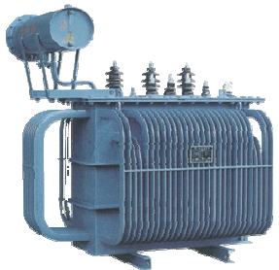
Power Transformers

Slide 16
Summary
A transformer consists of two coils, a primary winding and a secondary winding
An AC voltage is put across the primary winding, inducing a voltage in the secondary winding
Transformers allow an AC signal to be transferred from one circuit to another
Transformers are rated in volt-amperes(VA)
The turns ratio determines whether a transformer is used to step up, step down, or pass voltage unchanged
Transformer applications: impedance matching, phase shifting, isolation, blocking DC while passing AC, etc.

Slide 17
Electrical motors
ECE131
Basic Electrical & Electronics Engg

Slide 18
About Chapter
Describe types of electrical motors
State the working principle of DC motor, induction motor and synchronous motor
Identifying the direction of force acting on current carrying conductor in the magnetic field by using Fleming’s Left Hand Rule
Identifying a motor suits for a particular application

Slide 19
What is an electric motor?
An electric motor is an electromechanical device that converts electrical energy into mechanical energy.
All electric motors operate through the interaction of magnetic fields and current-carrying conductors to generate force.

Slide 20
Classification of Electric motors
Electrical motors are broadly classified on the availability of type of supply. They are,
DC motors
AC motors
DC/AC motors

Slide 21
How to find the direction of Force acting the conductor
According to the Faraday’s laws of electromagnetic induction,
whenever a current carrying conductor is placed in a magnetic field, it experiences a force.
The direction of force acting on the conductor is found by Fleming’s left Hand Rule.

Slide 22
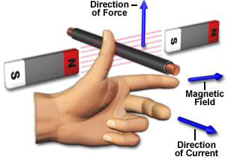
Flemings left hand rule
The direction of force exerted on the conductor is given by Fleming’s Left Hand Rule.
Thumb indicates the direction of force experienced by the conductor Index finger represents direction of magnetic field
Middle finger indicates direction of current

Slide 23
Principle of DC motors
The concept of working principle of DC motor involves the interaction of magnetic field and a current carrying conductor placed in it.
Let a straight conductor be placed in the magnetic field produced by a permanent magnet.
The interaction between the magnetic field and current carrying conductor is explained by Fleming’s right hand rule.

Slide 24
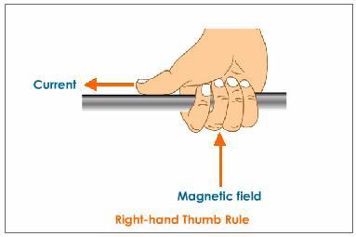
Right Hand Thumb Rule
When a current passes through a conductor, lines of magnetic force (flux) are generated around the conductor.
The direction of the flux is dependent on the direction of the current flow. The magnetic field produced by the conductor is shown in Figure above.
This can be found by using Right Hand Thumb Rule.
This rule states that If the thumb points in the direction of the current, then the curled fingers show the direction of the magnetic field.

Slide 25
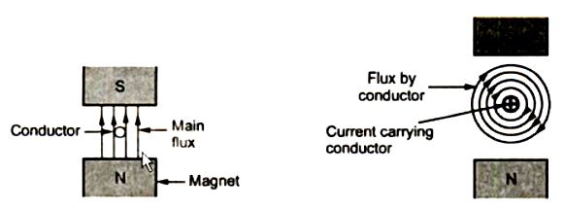
Conductor in a magnetic field, Flux produced by current carrying conductor

Slide 26
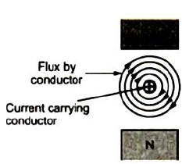
DC motors
Consider a conductor which is placed in a magnetic field (represented by flux lines from N-Pole to S-Pole) and the direction of current is as shown in the Figure shown in above slide.
Due to presence of two magnetic fields simultaneously, an interaction between them will take place as shown in Figure above.

Slide 27
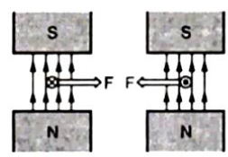
Magnitude of Force
The magnitude of the force experienced by the current carrying conductor placed in the magnetic field is given by
F = B I L Newton
Where,
B = Flux density (Wb)
I = Current flowing through the conductor (A)
L = Length of the conductor (m)

Slide 28
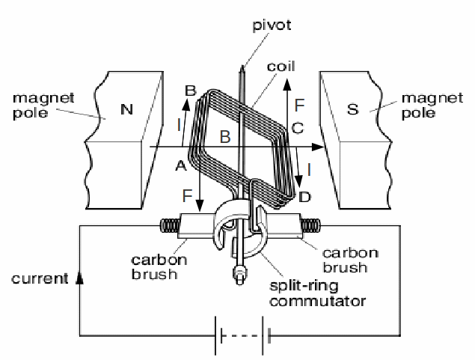
Principle of DC motor

Slide 29
Working of DC motor
Consider the direction of current flowing through the conductor in two coil sides, as from A to B in one side on the other side from C to D.
The force acting on the conductor side AB under North Pole can acts in downward direction by Flemings Left Hand Rule coil side CD under South Pole can acts in upward direction according to Fleming’s Left hand Rule.
So two forces can act simultaneously on the coil with same magnitude but in opposite directions such that the coil can start rotating in counter clock wise direction as shown in Figure above.
In this way, the coil starts rotating. This is the basic operation of DC motor.

Slide 30
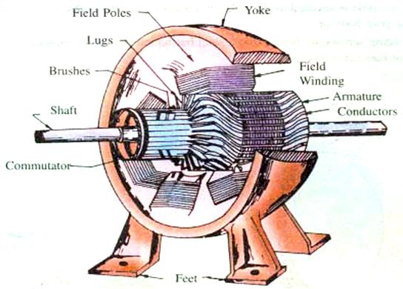
Construction of DC machine.

Slide 31
DC machines can be used as DC motors and generators
DC machine (which can be used as generator or motor) consists of,
Magnetic frame or Yoke
Pole-cores and Pole shoes
Pole coils or field coils
Armature core
Armature windings or conductors
Commutator
Brushes and bearings

Slide 32
Functions of various parts of DC machine
Yoke
The outer frame or yoke serves double purpose.
It provides mechanical support for the poles and acts as a protecting cover for the whole machine and It carries the magnetic flux produced by the poles.

Slide 33
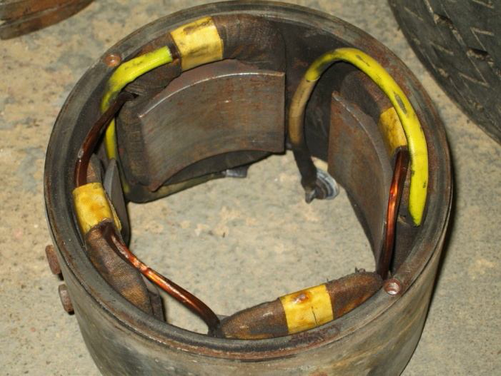
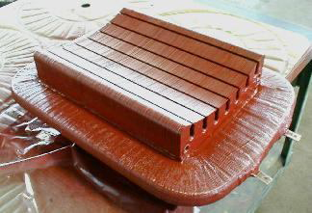
Pole cores/shoes
The field magnets consists of pole cores and pole shoes.
The pole shoes serve two purposes
They spread out the flux in the air gap and also, being of larger cross section reduce the reluctance of the magnetic path
They support the exciting coils (or field coils).

Slide 34
Field Poles

Slide 35
Pole Shoe

Slide 36
Pole Coils
The field coils or pole coils, which consist of copper wire of strip, are former-wound for the correct dimension.
Then the former is removed and wound coil is put into place over the core.
When current is passed through these coils, they electromagnetise the poles which produce the necessary flux that is cut by revolving armature conductors.

Slide 37
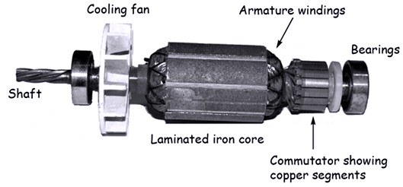
Armature core
It houses the armature conductors or coils and causes them to rotate and hence cut the magnetic flux of the field magnets.
Its most important function is to provide a path of very low reluctance to the flux through the armature from a N-pole to a S-pole.

Slide 38
Rotor of DC motor

Slide 39
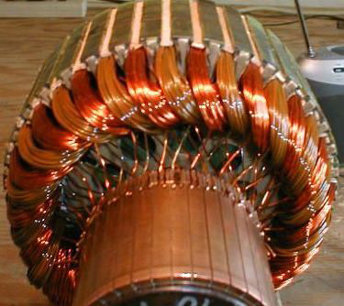
Armature windings
The armature windings are usually former-wound.
These are first wound in the form of flat rectangular coils and are then pulled into their proper shape in a coil puller.
Various conductors of the coils are insulated from each other.
The conductors are placed in the armature slots which are lined with tough insulating material.

Slide 40
Armature windings

Slide 41
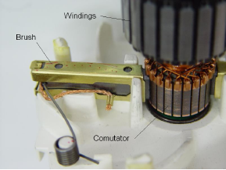
Commutator and brushes assembly

Slide 42
Commutator
The function of Commutator is to
facilitate collection of current from the armature conductors in case of generator i.e. as rectifier and
in case of motor which can provide current to the armature conductors i.e. as an inverter.

Slide 43
Brushes and Bearings
The brushes, whose function is to collect current from Commutator or to supply current to Commutator as in the case of generator and motor respectively, are usually made of carbon or graphite and are in the shape of a rectangular block.
https://www.youtube.com/watch?v=LAtPHANEfQo

Slide 44
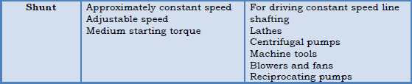

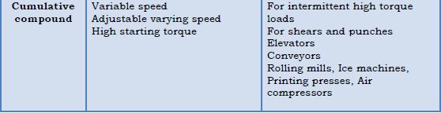
Applications of DC Motors

Slide 45
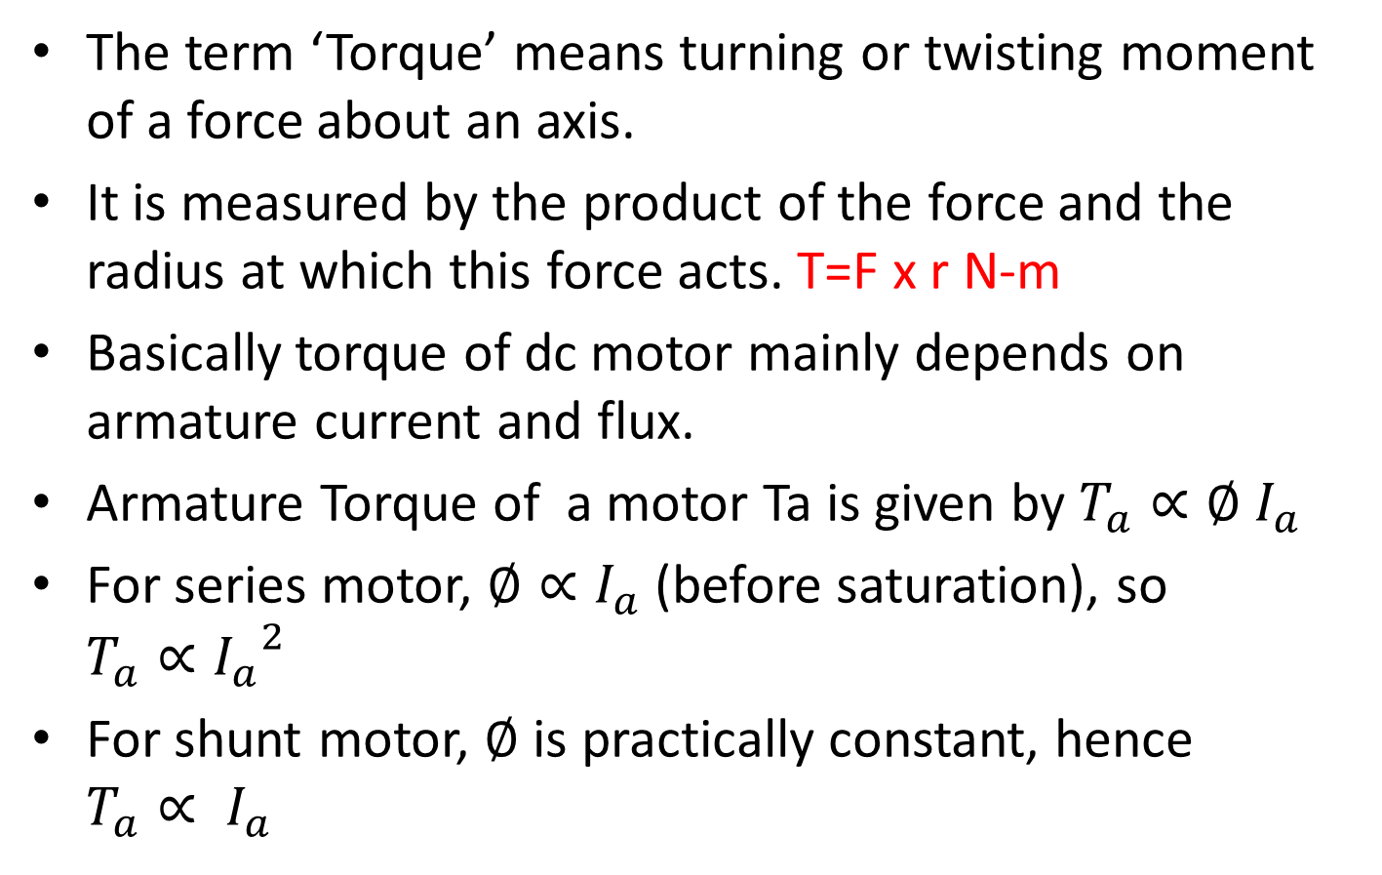
TORQUE
The term ‘Torque’ means turning or twisting moment of a force about an axis.
It is measured by the product of the force and the radius at which this force acts. T=F x r N-m
Basically torque of dc motor mainly depends on armature current and flux.
Armature Torque of a motor Ta is given by $T_{a}∝∅ I_{a}$
For series motor, $∅∝I_{a}$(before saturation), so $T_{a}∝{I_{a}}^{2}$
For shunt motor, $∅$ is practically constant, hence $T_{a}∝ I_{a}$

Slide 46
Why DC motors offer high as well as constant torque?
For a dc shunt motor, this flux is nearly a constant but for dc series motor this flux is mainly dependent on armature current, so torque of dc series motor is now dependent on square of armature current.
Hence it has a very high starting torque.

Slide 47
Types of AC motors
Synchronous
Permanent magnet synchronous motor
Switched reluctance synchronous motor
Hysteresis motor
Asynchronous (Induction motors)
Single-phase induction motors
Three-phase induction motors
Split phase induction motor
Squirrel cage
Slip-ring/wound rotor
Capacitor start induction motor
Shaded pole induction motor

Slide 48
Characteristics of motors
Depending upon the applications, motors can be designed according to the desired characteristics like,
Rotary
Linear
Servo
Spacecraft propeller
Generator

Slide 49
Applications of Electric motors
industrial fans
blowers and pumps
machine tools
household appliances
power tools
and disk drives

Slide 50
Application depends on Different sizes of motors
Smallest motors can be found in
Electric wrist watches
Medium size motors can be found
To provide convenient mechanical power for industrial use
The very largest electric motors are used
for propulsion of ships, pipeline compressors, and water pumps with ratings in the millions of watts.

Slide 51
Electric motors are classified on the basis of…
by the source of electric power
by their internal construction
by their application
or by the type of motion they give

Slide 52
That is the completion of Unit-3
ALL THE VERY BEST FOR YOUR MID TERM EXAMS!!

